Slide 1
Review of Risk Management Practice in Banking Industry
Dr. Gary G Lee for CMU MSCF, September 2017

Slide 2
Content
Review of Risk Management Practice in Banking Industry
Part I. Why Risk Management?
Financial Crisis and Banking Regulations
What Lessons Have We Learned From These Crises?
Evolution of Basel Accords: Basel I, II, II.5, III, and Upcoming
Part II. Risk Management Framework in U.S. Banks
Regulatory Expectation on Risk Management under Basel
Dodd-Frank Act and Its Influence on US Banks
OCC Heightened Standards for Large US Banks
Part III. Financial Engineering in Risk Management
Quantitative Risk Analysis – Basic Settings
Quantitative Risk Analysis – Risk Decomposition
Quantitative Risk Analysis – Capital to Capture Tail Risks
Appendix:
Homework set (spreadsheet)
Reading materials for Basel Capital Rules

Slide 3
Why Risk Management?
“Principle 1: Banks should have a process for assessing their overall capital adequacy in relation to their risk profile and a strategy for maintaining their capital levels.
A sound risk management process is the foundation for an effective assessment of the adequacy of a bank’s capital position. Bank management is responsible for understanding the nature and level of risk being taken by the bank and how this risk relates to adequate capital levels. It is also responsible for ensuring that the formality and sophistication of the risk management processes are appropriate in light of the risk profile and business plan.”
-- Basel II: The Second Pillar – Supervisory Review Process (2006)
“A covered bank should establish and adhere to a formal, written risk governance framework that is designed by independent risk management and approved by the board of directors or the board’s risk committee… The risk governance framework should cover the following risk categories that apply to the covered bank: credit risk, interest rate risk, liquidity risk, price risk, operational risk, compliance risk, strategic risk, and reputation risk...”
-- OCC Guidelines Establishing Heightened Standards for Large Financial Institutions (2014)
Question: While the risk management practice has been widely adopted by the banking industry, why does it receive
such a high level of scrutiny from the banking regulators across the global financial system?

Slide 4
Banking regulations and Financial Crisis
In the modern history of banking, many regulations were created in the wakes of financial crises
Financial crises can be attributed to many causes ranging from economic recessions, sovereign defaults and currency devaluations, stock market crashes, asset bubbles, etc.
Examples of financial crises since the 20th century:
Great Depression of the 1930’s
S&L Bank Crisis of the 1980s
Emerging Market Currency Crisis 1997-1998 (Asia and Russia)
Global Financial Crisis 2007-2009
Major Banking regulations
US Banking Act of 1933 (Glass-Steagall Act)
Financial Institutions Reform, Recovery and Enforcement Act of 1989 (FIRREA)
Dodd–Frank Wall Street Reform and Consumer Protection Act of 2010 (DFA)
Question: Why did these financial crises lead to considerations by the government for more and stricter regulations?

Slide 5
Great Depression vs. Glass Steagall Act (1933)
The Great Depression of 1930s
Outcome:
The U.S. economy dropped 30% by 1933
Stock market lost 90% of its value
Unemployment rate reached 25%...
Bank runs
More than one third of the 25,000 US banks failed…
Causes:
Ill-regulated banks made excessive loans and speculative investments in the stock market.
Solution: The US Banking Act of 1933 (Glass–Steagall Act)
Separate commercial and investment banking by limiting securities, activities, and affiliations within commercial banks and securities firms. With the exception of commercial banks being allowed to underwrite government-issued bonds, commercial banks could only have ten percent of their income come from securities.
Created the Federal Deposit Insurance Corporation (FDIC) to provide insurance to depositors in US banks, in order to restore trust in the US banking system and prevent bank-runs.

Slide 6
Savings and Loan Crisis vs. FIRREA (1989)
S&L and Bank Crisis of the 1980s
A savings and loan or "thrift" accepts savings deposits and makes mortgage, car and other personal loans; many of them are not-for-profit cooperative associations to serve members of aspiring homeowners. There were more than three thousand thrifts or S&Ls besides banks in the United States. However, about one thousand, or one third, of these S&Ls failed along many banks from 1986 to 1995. This crisis was referred to as the savings and loan crisis of the 1980s and 1990s (commonly dubbed the S&L Crisis).
The collapse of S&Ls took over a decade to develop under an unusual macroeconomic situation starting in the late 1970s,and its causes were very complicated. Essentially, the high inflation sparked by the energy crisis in 1979 and the subsequent rapidly rising interest rates cast serious challenges and threats to the financial health of the thrift industry. To counter the suppressed interest margins, the S&Ls resorted to unsound real estate lending. It was estimated that S&Ls had loan assets of $600 billion, of which $480 billion were mortgage loans, or 50 percent of the entire home mortgage market by then. The problems were compounded by poor credit risk management on these residential and commercial mortgage loans. Additionally, these institutions poorly managed their interest rate risk leading to balance sheets with long term, low fixed rate mortgage/loan assets and short term floating rate liabilities during a high inflation era.
Financial Institutions Reform, Recovery and Enforcement Act of 1989 (FIRREA)
Created Office of Thrift Supervisions (OTS) to regulate S&Ls
Established Savings Association Insurance Fund (SAIF) as an ongoing insurance fund for thrifts (like FDIC)
Gave Freddie Mac and Fannie Mae additional responsibility to support mortgages for low/moderate-income families
Required S&Ls to meet minimum capital standards, raised deposit-insurance premiums, and limited to no more than 30% of their portfolios loans in residential mortgages or mortgage-related securities

Slide 7
Global Financial Crisis vs. Dodd Frank Act (2010)
Global Financial Crisis 2007-2009
The Global Financial Crisis of 2007–09 is considered to be the worst since the Great Depression of the 1930s. Many financial institutions failed with sizes never seen before and threatened the collapse of the global financial system, which was prevented by the bailout of banks by national governments. The bank failures led the global economy into a great recession and contributed to some European sovereign-debt defaults.
The causes for the crisis were comprehensive. The burst of the US housing bubble starting in 2004 triggered the failure of Northern Rock, IndyMac, RBC, Lloyds, Bear Sterns, Lehman Brothers, AIG, Fannie Mae, Freddie Mac, Wachovia, WaMu, NatCity etc., and weakened almost all financial institutions by incurring severe losses in mortgage loans, sub-prime based securitization holdings and credit default products, and creating stressed liquidity shortages. The impacts were systemic and the US banks’ losses amounted to $1.6tn or about 60% of their values.
Dodd-Frank Wall Street Reform and Consumer Protection Act of 2010 (DFA)
Among others, DFA brought the most significant changes to financial regulations since the Great Depression, aiming to end "too big to fail“ banks, to protect taxpayers by ending bailouts and to protect consumers from abusive practice;
It created or enhanced the power of FRB/OCC/FDIC/SEC, eliminated OTS and phased out Fannie Mae and Freddie Mac;
It included a part, commonly dubbed as the ‘Volcker Rule’, which bans proprietary trading by commercial banks and limits banking entities to have ownership in hedge funds or private equity funds.
Basel III (2010)
A new standard under the international banking supervision accord, Basel III, was released which, unlike Basel I and Basel II, focuses on preventing bank failures and establishes a much broader framework on bank capital adequacy, stress testing and market liquidity risk.

Slide 8
What Lessons Have We Learned from These Financial Crises?
Risk Management is Capital Management!
Banking is a risk-taking business. These risks include credit risk, liquidity risk, investment risk, interest rate risk, trading risk, operational risk, compliance risk, reputation risk, model risk, etc.
The risks in the banking business can not be eliminated, but can and should be managed. Risk management is the foremost defense against them. (Basel III Pillar Two; OCC Heightened Standards for Large Banks)
Capital adequacy was severely underestimated under the Basel I/II capital standards and could not withstand stressed economic conditions (Basel III and US Comprehensive Capital Analysis and Review (CCAR)/Dodd Frank Act Stress Test (DFAST))
No regulatory restriction on the leverage that banks can take to expand their investments (Basel III Leverage Limit)
No quantitative regulatory requirement for banks to maintain sufficient liquidity (Basel III Liquidity Coverage Ratio (LCR)/Net Stable Funding Ratio (NSFR))
Moral Hazard: (Dodd-Frank Act of 2010 / Volcker Rule)
Banks are implicitly protected by governments (e.g. FDIC in the US). When banks become too big to fail, governments have to bail them out, if their failure threatens the health of the whole economy.
Therefore, there should be regulatory boundaries set for banks so their business strategies would not lead to exposing the economy to a systemic risk.
All of these crises led to the establishment of the risk management framework for the U.S. banking industry practice, which is based on the Basel Accords and guided by the referenced laws and regulations.

Slide 9
Evolution of Basel Accords: Basel I
Basel Accords refer to a set of recommendations for regulations in the banking industry issued by the Basel Committee on Banking Supervision (BCBS), which consists of representatives from central banks and regulatory authorities of G20 and other major economies in the world.
Basel I was published in 1988 and enforced in the G10 countries in 1992:
Focused on credit risk and introduced a Standardized Approach (SA) to calculates risk weighted assets (RWA) using risk weights assigned based on credit quality:
0% for cash, bullion, sovereign bonds;
20% for securitizations like MBS with AAA rating;
50% for municipal revenue bonds, residential mortgages loans;
100% for most corporate loans and debt;
The RWA for off-balance-sheet swaps is set via a ‘Conversion Factor’ to a loan-equivalent exposure, or exposure at default (EAD) with 100% risk weight.
The concept of RWA is built on an assumption that the loss rate is set at 8% for one unit of risk weighted asset:
Capital Requirement = 8% of RWA or RWA = 12.5 * Capital Requirement
If the loss of one asset class is higher (lower) than 8%, its risk weight relative to the RWA would be higher (lower) than 100% by the loss ratio. For instance, by assigning 50% for the mortgage loans, it implies a loss rate of 4% assumed by the Basel I Capital Accord to this loan asset class that is backed by home properties.
Therefore, the Minimum Capital requirement for a bank is to have more capital to cover 8% of its calculated RWA. In other words, the ratio of its capital to RWA should be higher than 8% under Basel I.

Slide 10
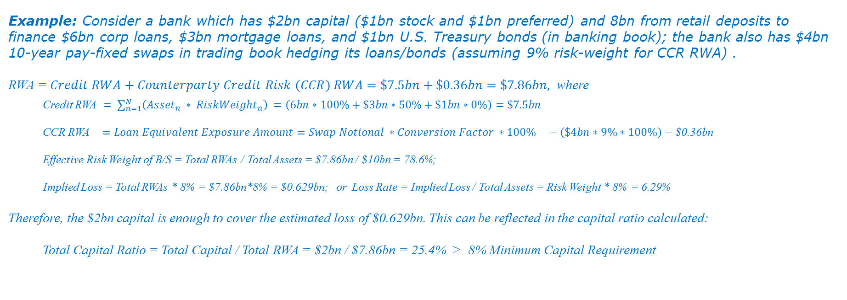
RWA and Capital Ratio Calculations under Basel I
Example: Consider a bank which has $2bn capital ($1bn stock and $1bn preferred) and 8bn from retail deposits to finance $6bn corp loans, $3bn mortgage loans, and $1bn U.S. Treasury bonds (in banking book); the bank also has $4bn 10-year pay-fixed swaps in trading book hedging its loans/bonds (assuming 9% risk-weight for CCR RWA) .
RWA = $Credit RWA+Counterparty Credit Risk (CCR) RWA$ $=\$7.5bn+\$0.36bn=\$7.86bn,$ where
Credit RWA $= \sum_{n=1}^{N}{\left({Asset}_{n} ∗ {RiskWeight}_{n}\right) }=\left(6bn∗100\%+\$3bn∗50\%+\$1bn∗0\%\right)=\$7.5bn$
CCR RWA $={Loan Equivalent Exposure Amount=Swap Notional ∗Conversion Factor ∗100\% }_{}$ = $\left(\$4bn∗9\%∗100\%\right)$ = $0.36bn
Effective Risk Weight of B/S = Total RWAs / Total Assets = $7.86bn / $10bn = 78.6%;
Implied Loss = Total RWAs * 8% = $7.86bn*8% = $0.629bn; or Loss Rate = Implied Loss / Total Assets = Risk Weight * 8% = 6.29%
Therefore, the $2bn capital is enough to cover the estimated loss of $0.629bn. This can be reflected in the capital ratio calculated:
Total Capital Ratio = Total Capital / Total RWA = $2bn / $7.86bn = 25.4% > 8% Minimum Capital Requirement

Slide 11
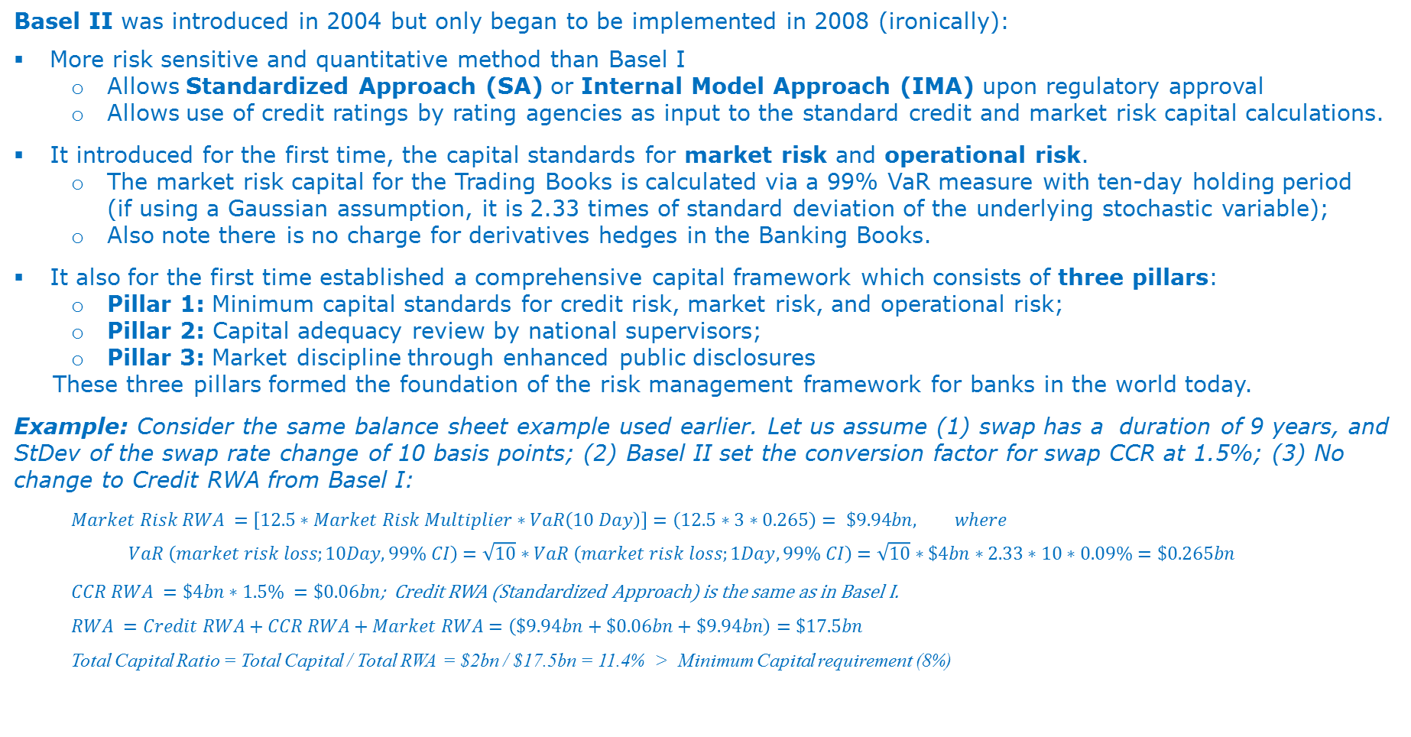
Evolution of Basel Accords: Basel II
Basel II was introduced in 2004 but only began to be implemented in 2008 (ironically):
More risk sensitive and quantitative method than Basel I
Allows Standardized Approach (SA) or Internal Model Approach (IMA) upon regulatory approval
Allows use of credit ratings by rating agencies as input to the standard credit and market risk capital calculations.
It introduced for the first time, the capital standards for market risk and operational risk.
The market risk capital for the Trading Books is calculated via a 99% VaR measure with ten-day holding period (if using a Gaussian assumption, it is 2.33 times of standard deviation of the underlying stochastic variable);
Also note there is no charge for derivatives hedges in the Banking Books.
It also for the first time established a comprehensive capital framework which consists of three pillars:
Pillar 1: Minimum capital standards for credit risk, market risk, and operational risk;
Pillar 2: Capital adequacy review by national supervisors;
Pillar 3: Market discipline through enhanced public disclosures
These three pillars formed the foundation of the risk management framework for banks in the world today.
Example: Consider the same balance sheet example used earlier. Let us assume (1) swap has a duration of 9 years, and StDev of the swap rate change of 10 basis points; (2) Basel II set the conversion factor for swap CCR at 1.5%; (3) No change to Credit RWA from Basel I:
$$Market Risk RWA =\left[12.5∗Market Risk Multiplier∗VaR\left(10 Day\right)\right]=\left(12.5∗3∗0.265\right)= \$9.94bn, where$$
$$VaR \left(market risk loss;10Day, 99\% CI\right)=\sqrt{10}∗VaR \left(market risk loss;1Day, 99\% CI\right)=\sqrt{10}∗\$4bn∗2.33∗10∗0.09\%=\$0.265bn$$
$CCR RWA =\$4bn∗1.5\% =\$0.06bn$; Credit RWA (Standardized Approach) is the same as in Basel I.
$$RWA =Credit RWA+CCR RWA+Market RWA=\left(\$9.94bn+\$0.06bn+\$9.94bn\right)=\$17.5bn$$
Total Capital Ratio = Total Capital / Total RWA = $2bn / $17.5bn = 11.4% > Minimum Capital requirement (8%)

Slide 12
Evolution of Basel Accords: Basel 2.5
Basel 2.5 - Market Risk Capital Rule
Basel 2.5 was published in 2009
In response to the Global Financial Crisis started in 2007.
Included collective revisions to the market risk capital standards with improvements
Implementation started in 2013 in the U.S.
Basel 2.5 in Comparison to Basel 2:
Retained the regular or general VaR method for measuring market risks
Enhanced the rule’s sensitivity to risks not adequately captured, including default and credit migration, by the VaR measure.
A specific risk add-on charge to account for the risk of loss on a position due to factors other than broad-based movements in market prices, and thereby are particularly important to traded credit and other structured products, such as credit default swaps (CDSs) and asset-backed securities, that banks had increasingly used in the period leading up to the Financial Crisis.
An additional market capital charge through ‘Stressed VaR’ to address a shortcoming of Regular VaR that underestimates market risk exposures in a low volatility period thus encouraging pro-cyclical behavior. On average, the industry estimated that Stressed VaR is about 3X of Regular VaR.
Total Market Risk Measure =
(General Value-at-Risk based capital requirement)
+ (Stressed Value-at-Risk based capital requirement)
+ (Specific risk capital charge) + (Incremental risk capital requirement)
+ (Comprehensive risk capital requirement) + (Capital charge for de minimis exposures)

Slide 13
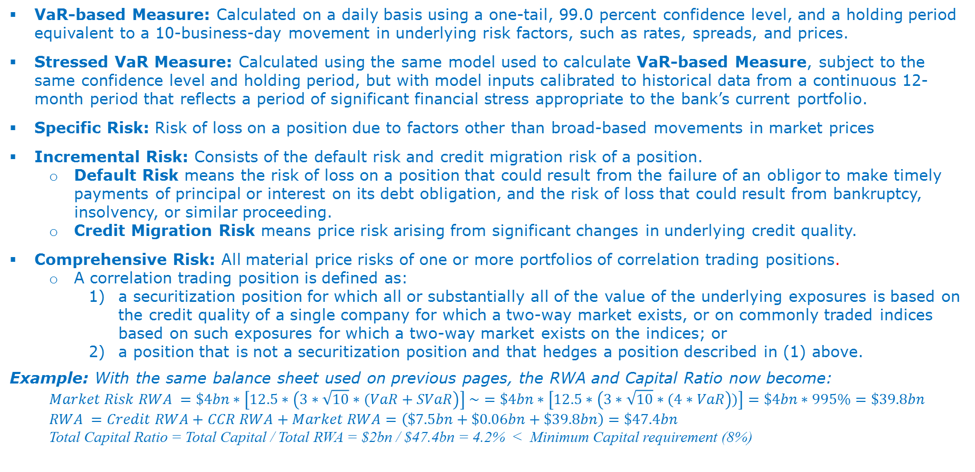
Appendix: Basel 2.5 Definitions
VaR-based Measure: Calculated on a daily basis using a one-tail, 99.0 percent confidence level, and a holding period equivalent to a 10-business-day movement in underlying risk factors, such as rates, spreads, and prices.
Stressed VaR Measure: Calculated using the same model used to calculate VaR-based Measure, subject to the same confidence level and holding period, but with model inputs calibrated to historical data from a continuous 12-month period that reflects a period of significant financial stress appropriate to the bank’s current portfolio.
Specific Risk: Risk of loss on a position due to factors other than broad-based movements in market prices
Incremental Risk: Consists of the default risk and credit migration risk of a position.
Default Risk means the risk of loss on a position that could result from the failure of an obligor to make timely payments of principal or interest on its debt obligation, and the risk of loss that could result from bankruptcy, insolvency, or similar proceeding.
Credit Migration Risk means price risk arising from significant changes in underlying credit quality.
Comprehensive Risk: All material price risks of one or more portfolios of correlation trading positions.
A correlation trading position is defined as:
a securitization position for which all or substantially all of the value of the underlying exposures is based on the credit quality of a single company for which a two-way market exists, or on commonly traded indices based on such exposures for which a two-way market exists on the indices; or
a position that is not a securitization position and that hedges a position described in (1) above.
Example: With the same balance sheet used on previous pages, the RWA and Capital Ratio now become:
$$Market Risk RWA =\$4bn∗\left[12.5∗\left(3∗\sqrt{10}∗(VaR+SVaR\right)\right] \sim =\$4bn∗\left[12.5∗\left(3∗\sqrt{10}∗(4∗VaR\right))\right]=\$4bn∗995\%=\$39.8bn$$
$$RWA =Credit RWA+CCR RWA+Market RWA=\left(\$7.5bn+\$0.06bn+\$39.8bn\right)=\$47.4bn$$
Total Capital Ratio = Total Capital / Total RWA = $2bn / $47.4bn = 4.2% < Minimum Capital requirement (8%)

Slide 14
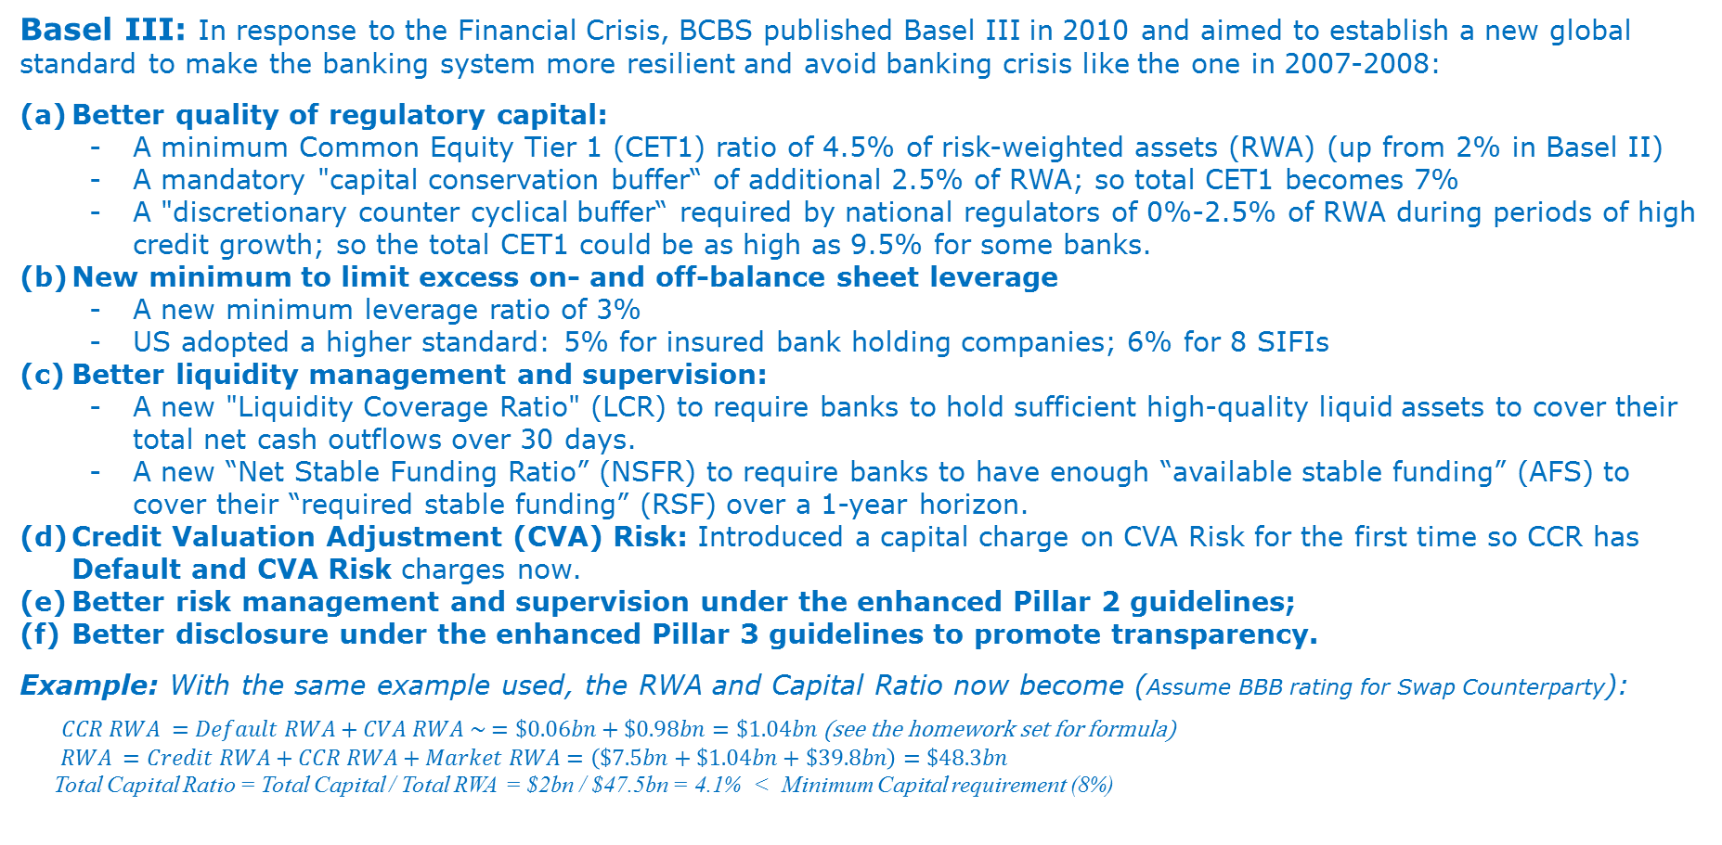
Evolution of Basel Accords: Basel III
Basel III: In response to the Financial Crisis, BCBS published Basel III in 2010 and aimed to establish a new global standard to make the banking system more resilient and avoid banking crisis like the one in 2007-2008:
Better quality of regulatory capital:
A minimum Common Equity Tier 1 (CET1) ratio of 4.5% of risk-weighted assets (RWA) (up from 2% in Basel II)
A mandatory "capital conservation buffer“ of additional 2.5% of RWA; so total CET1 becomes 7%
A "discretionary counter cyclical buffer“ required by national regulators of 0%-2.5% of RWA during periods of high credit growth; so the total CET1 could be as high as 9.5% for some banks.
New minimum to limit excess on- and off-balance sheet leverage
A new minimum leverage ratio of 3%
US adopted a higher standard: 5% for insured bank holding companies; 6% for 8 SIFIs
Better liquidity management and supervision:
A new "Liquidity Coverage Ratio" (LCR) to require banks to hold sufficient high-quality liquid assets to cover their total net cash outflows over 30 days.
A new “Net Stable Funding Ratio” (NSFR) to require banks to have enough “available stable funding” (AFS) to cover their “required stable funding” (RSF) over a 1-year horizon.
Credit Valuation Adjustment (CVA) Risk: Introduced a capital charge on CVA Risk for the first time so CCR has Default and CVA Risk charges now.
Better risk management and supervision under the enhanced Pillar 2 guidelines;
Better disclosure under the enhanced Pillar 3 guidelines to promote transparency.
Example: With the same example used, the RWA and Capital Ratio now become (Assume BBB rating for Swap Counterparty):
$CCR RWA =Default RWA+CVA RWA \sim =\$0.06bn+\$0.98bn=\$1.04bn$(see the homework set for formula)
$RWA =Credit RWA+CCR RWA+Market RWA=\left(\$7.5bn+\$1.04bn+\$39.8bn\right)=\$48.3bn$
Total Capital Ratio = Total Capital / Total RWA = $2bn / $47.5bn = 4.1% < Minimum Capital requirement (8%)

Slide 15
Evolution of Basel Accords: From Basel I to Basel III
What are the impacts on banks’ regulatory capital along the evolutions in Basel Rules?

Slide 16
Appendix: Definition of Capital Ratios
Tier 1 capital is the core measure of a bank's financial strength and composed of Common Equity Tier 1 (CET1, primarily of common stock, disclosed reserves and retained earnings) and other Tier 1 capital like non-cumulative preferred stock.
Total Capital consists of Tier 1 Capital and Tier 2 Capital (supplemental capital such as valuation reserves, undisclosed reserves, hybrid instruments and subordinate term debt)
Risk Weighted Assets (RWA)
RWA is the sum of a bank’s assets weighted by the weights assessed against the credit risk, market risk and operational risk these assets are exposed to.
Basel III allows both Standard Approach (SA) and Internal Model Method (IMM) to calculate RWAs. Under SA, the risk weights are determined by the rules set in Basel III; under IMM, the RWA is converted from the risk exposures estimated by the internal models (see detailed explanations in Part III).
Capital Ratios
Basel III established a set of minimum standards on the capital ratios which are simply the ratios of corresponding capital measure to the sum of all assets (Total Assets) or the risk-weighted assets (RWA);
Leverage Ratio is the ratio of Tier 1 Capital to the Total Assets.

Slide 17
Upcoming Basel Rules
The Basel standards are still evolving with several major capital rules recently introduced or to be finalized, which could impact the banking industry significantly. They include:
Fundamental Review of Trading Book (FRTB) is the revised capital standard of market risk capital over Basel 2.5. It was published in January 2016 and expected to be implemented before 2020.
Revised internal models-approach (IMA) with a shift from Value-at-Risk (VaR) to an Expected Shortfall (ES) measure of risk to better capture “tail risk”;
Revised standardized approach (SA) that is fundamentally overhauled to be risk-sensitive to serve as a credible fallback for, as well as a floor to, the IMA;
Incorporation of market liquidity risk with varying liquidity horizons by risk factors to mitigate sudden and severe impairments of market liquidity (assumed 10-day universally under Basel 2.5)
Interest Rate Risk in the Banking Book (IRRBB) was a major update to the Basel Supervisory Review (Pillar 2) framework of assessing the capital adequacy related to the interest rate risk (IRR) in the banking book. It was published in April 2016 and expected to be implemented by the end of 2017.
IRRBB was short of becoming a capital standard, but it revised the IRR Principles and the methods expected to be used by banks for measuring, managing, monitoring and controlling IRR, including disclosing the impact of interest rate shocks on their change in economic value of equity (ΔEVE) and net interest income (ΔNII);
IRRBB also set up a threshold to identify “outlier bank” of IRRBB exposure by comparing the stressed EVE lost to 15% of its Tier 1 capital which could lead to supervisory and/or regulatory capital consequences
CVA Capital – Changes to the original CVA RWA methodologies introduced under Basel III are intended to include market risks and enhance the risk sensitivity of the methodologies.

Slide 18
Content
Review of Risk Management Practice in Banking Industry
Part I. Why Risk Management?
Financial Crisis and Banking Regulations
What Lessons Have We Learnt from These Crisis?
Evolution of Basel Accords: Basel I, II, II.5, III
Part II. Risk Management Framework in the U.S. banks
Regulatory Expectation on Risk Management under Basel
Dodd-Frank Act and Its Influence on US Banks
OCC Heightened Standards for Large US Banks
Part III. Financial Engineering in Risk Management
Quantitative Risk Analysis – Basic Settings
Quantitative Risk Analysis – Risk Decomposition
Quantitative Risk Analysis – Capital to Capture Tail Risks

Slide 19
Regulatory Expectation on Risk Management Under Basel
Basel Requirements on Risk Management:
Although the risk management practice has long been adopted by the banking industry, especially in the areas of credit and trading risks, it was not set up with a rigorous framework until the establishment of the Basel II Accord. The Supervisory Review, - the second of the Basel II’s three foundational pillars, states in its foremost principle that:
“A sound risk management process is the foundation for an effective assessment of the adequacy of a bank’s capital position...”
“The bank’s board of directors has responsibility for setting the bank’s tolerance for risks. It should also ensure that management establishes a framework for assessing the various risks, develops a system to relate risk to the bank’s capital level, and establishes a method for monitoring compliance with internal policies…”
Risk Management is viewed as Capital Management!
The oversight responsibility of the Board sets the stature of risk management in a banking institution.

Slide 20
Expansion of Risk Coverage under Basel Capital Standards
Basel III Expansion on Risk Coverage under Capital Standards
Basel III introduced a requirement on Leverage Ratio as part of capital management
“One of the main reasons the economic and financial crisis became so severe was that the banking sectors of many countries had built up excessive on- and off-balance sheet leverage… The banking system came under severe stress, which necessitated central banks’ actions to support both the functioning of money markets and, in some cases, individual institutions.”
Basel III introduced a requirement on Liquidity Ratios (LCR & NSFR) as part of capital management
“At the same time, many banks were holding insufficient liquidity buffers. The banking system therefore was not able to absorb the resulting systemic trading and credit losses nor could it cope with the re-intermediation of large off-balance sheet exposures that had built up in the shadow banking system.”
Basel III introduced capital a charge on Credit Valuation Adjustment (CVA) for Counterparty Credit Risk
“Banks will be subject to a capital charge for potential mark-to-market losses (i.e. credit valuation adjustment – CVA – risk) associated with a deterioration in the credit worthiness of a counterparty. While the Basel II standard covers the risk of a counterparty default, it does not address such CVA risk, which during the financial crisis was a greater source of losses than those arising from outright defaults. One of the main reasons the economic and financial crisis became so severe was that the banking sectors of many countries had built up excessive on- and off-balance sheet leverage.”

Slide 21
Dodd-Frank Act and Its Influence on US Banks
In addition to the Basel capital standards, the Dodd-Frank Wall Street and Consumer Protection Act of 2010 (DFA) brought the most significant changes to the financial regulation in the U.S. since the Great Depression. It was estimated to have a total of 390 rulemaking requirements, of which we have seen only 274 or 70.3% make it to the finalized rules as of July, 2016. Among these rules, the CCAR/DFAST and Volcker Rule are two of the most significant implementations to large banks.
CCAR and DFAST
The DFA requires an annual Comprehensive Capital Analysis and Review (CCAR) and a mid-cycle Dodd-Frank Act Stress Test (DFAST) for large US banks. The purpose is to ensure that large banks are managing and allocating its capital resources to maintain health condition of their institutions and thus the stability and effective functioning of the U.S. financial system.
The stress tests are run against the supervisory-prescribed as well as company-defined scenarios. They are designed to provide forward looking estimation of the potential effect on the ability of these large banking organizations under these stressed scenarios to absorb losses and continue to serve as credit intermediaries.
Volcker Rule (2014)
The Volcker Rule prohibits banking entities from engaging in proprietary trading or acquiring or retaining an ownership interest in, or having certain relationships with, a covered fund;
However, it permits banking entities to continue to provide, and to manage and limit the risks associated with providing, client-oriented financial services that are critical to capital generation for businesses of all sizes, households and individuals, and that facilitate liquid markets.
The DFA reform has reshaped the US banking industry. There are on-going debates about many of the rules of implementations regarding their scope and contents.

Slide 22
OCC Heightened Standards for Large U.S. Banks (1)
With the new regulatory reform under Basel III and DFA, the Office of the Comptroller of the Currency (OCC) went further to publish the guidelines of the design and implementation of a risk governance framework for large banks*
Risk Governance Framework
Covered banks should establish and adhere to a formal, written risk governance framework designed by independent risk management. It should include delegations of authority from the board of directors to management committees and executive officers as well as risk limits established for material activities.
Three Lines of Defense
Front Line Units, the first line of defense, should take responsibility and be held accountable by the CEO and the board of directors for appropriately assessing and effectively managing all of the risks associated with their activities.
Independent Risk Management, the second line of defense, should oversee the covered bank’s risk-taking activities and assess risks and issues independent of the front line units.
Internal Audit, the third line of defense, should ensure that the covered bank’s risk management framework complies with the Guidelines and is appropriate for the size, complexity, and risk profile of the covered bank.
CEO and Strategic Plan
The CEO, with input from front line units, independent risk management, and internal audit, should be responsible for the development of a written strategic plan that should cover, at a minimum, a three-year period. The board of directors should evaluate and approve the plan and monitor management’s efforts to implement the strategic plan at least annually.

Slide 23
OCC Heightened Standards (2): Three Lines of Defense
Chief Executive Officer
Wholesale Banking
Retail Banking
Asset Management
Other Businesses
Independent Risk Organization
Internal Audit
Board of Directors
* Liquidity Risk
* Credit Risk
* Interest Rate Risk
* Price Risk
* Operational Risk
* Compliance Risk
* Strategic Risk
* Reputation Risk
Unrestricted Access
1st Line of Defense
2nd Line of Defense
3rd Line of Defense

Slide 24
Appendix: Risk Terminology (1)
Risk Appetite: The aggregate level and types of risk, the board of directors and management are willing to assume to achieve the bank’s strategic objectives and business plan.
Scope of Risk Governance: The categories should include credit risk, liquidity risk, interest rate risk, price risk, operational risk, compliance risk, strategic risk, and reputation risk.
Liquidity Risk is the risk to current or projected financial condition and resilience arising from an inability to meet obligations when they come due. Liquidity risk includes the inability to access funding sources or manage fluctuations in funding levels. Liquidity risk also results from a bank’s failure to recognize or address changes in market conditions that affect its ability to liquidate assets quickly and with minimal loss in value.
Credit risk is the risk arising from an obligor’s failure to meet the terms of any contract with the bank or otherwise perform as agreed. Credit risk is found in all activities in which settlement or repayment depends on counterparty, issuer, or borrower performance. Credit risk exists any time bank funds are extended, committed, invested, or otherwise exposed through actual or implied contractual agreements, whether reflected on or off the balance sheet.
Interest Rate Risk is the risk arising from movements in interest rates. Interest rate risk results from differences between the timing of rate changes and the timing of cash flows (repricing risk); from changing rate relationships among different yield curves affecting bank activities (basis risk); from changing rate relationships across the spectrum of maturities (yield curve risk); and from interest-related options embedded in bank products (options risk).
Price Risk is the risk arising from changes in the value of either trading portfolios or other obligations that are entered into as part of distributing risk. These portfolios typically are subject to daily price movements and are accounted for primarily on a mark-to-market basis. This risk occurs most significantly from market-making, dealing, and position-taking in interest rate, foreign exchange, equity, commodities, and credit markets.
Market Risk usually refers to a combination of price risk and interest rate risk.

Slide 25
Appendix: Risk Terminology (2)
Operational Risk is the risk arising from inadequate or failed internal processes or systems, human errors or misconduct, or adverse external events. Operational losses result from internal fraud; external fraud; inadequate or inappropriate employment practices and workplace safety; failure to meet professional obligations involving clients, products, and business practices; damage to physical assets; business disruption and systems failures; and failures in execution, delivery, and process management. Model Risk is considered part of Operational Risk.
Compliance Risk is the risk arising from violations of laws or regulations, or from nonconformance with prescribed practices, internal policies and procedures, or ethical standards. This risk exposes a bank to fines, civil money penalties, payment of damages, and the voiding of contracts. Compliance risk can result in diminished reputation, limited business opportunities, and lessened expansion potential.
Strategic Risk is the risk arising from adverse business decisions, poor implementation of business decisions, or lack of
responsiveness to changes in the banking industry and operating environment. This risk is a function of a bank’s strategic goals, business strategies, resources, and quality of implementation. The resources needed to carry out business strategies are both tangible and intangible. They include communication channels, operating systems, delivery networks, and managerial capacities and capabilities.
Reputation Risk is the risk arising from negative public opinion. This risk may impair a bank’s competitiveness by affecting its ability to establish new relationships or services or continue servicing existing relationships. Reputation risk is inherent in all bank activities and requires management to exercise an abundance of caution in dealing with stakeholders, such as customers, counterparties, correspondents, investors, regulators, employees, and the community.

Slide 26
Appendix: Rogue Traders
Over the years, banks have suffered colossal financial losses due to rogue traders who made unauthorized trades or hid risk exposures after building positions. These cases exposed the weakness and gaps in banks’ risk management practices and operation processes. The following is the Top 5 list, per Wikipedia.

Slide 27
Content
Review of Risk Management Practice in Banking Industry
Part I. Why Risk Management?
Financial Crisis and Banking Regulations
What Lessons Have We Learnt from These Crisis?
Evolution of Basel Accords: Basel I, II, II.5, III
Part II. Risk Management Framework in the U.S. banks
Regulatory Expectation on Risk Management under Basel
Dodd-Frank Act and Its Influence on US Banks
OCC Heightened Standards for Large US Banks
Part III. Financial Engineering in Risk Management
Quantitative Risk Analysis – Basic Settings
Quantitative Risk Analysis – Risk Decomposition
Quantitative Risk Analysis – Capital to Capture Tail Risks

Slide 28
Risk Management vs Financial Engineering
Quantitative analytics has increasingly become one of the major tools for banks in their decision makings. The application of the quantitative analytics, - ‘financial engineering’, can be found in:
Setting up business and investment strategies:
Establishing loan underwriting standards,
Developing wholesale deposit pricing strategy,
Designing capital allocation and investment strategies,
Assessing investment valuations,
Pricing and trading financial instruments and derivatives.
Risk Management
Measuring the risk exposures to associated financial markets including the interest rate, credit spread, foreign exchange, equity and commodity markets, etc.
Designing and executing risk mitigation or hedging strategies against these risks.
The implementation of Basel III after the financial crisis of 2007-09:
Put its focus on linking capital to exposures across the whole risk spectrum.
Financial engineering has been elevated as the most important and effective tool for banks in managing its risks and capital.
The demand for financial engineering, or computational finance, expertise and talent has grown rapidly in recent years.
Financial Modeling is a central element of financial engineering. OCC recently published an enhanced guidance on model risk management in 2011, highlighting the challenges faced in expanding the usages of quantitative analytics and modeling techniques in the banking industry.

Slide 29
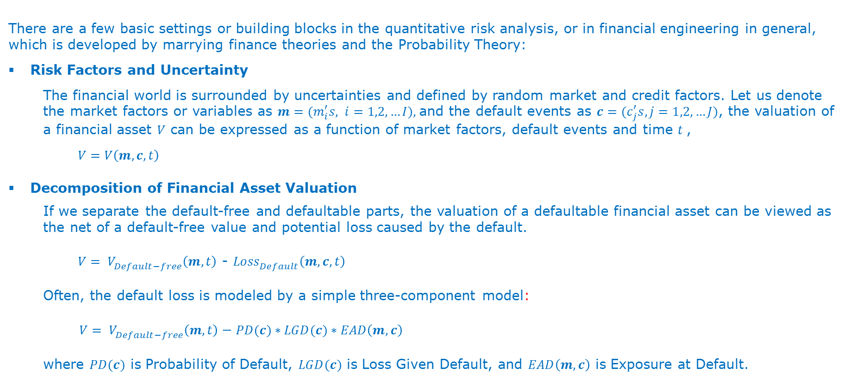
Quantitative Risk Analysis – Basic Settings
There are a few basic settings or building blocks in the quantitative risk analysis, or in financial engineering in general, which is developed by marrying finance theories and the Probability Theory:
Risk Factors and Uncertainty
The financial world is surrounded by uncertainties and defined by random market and credit factors. Let us denote the market factors or variables as ${m=(m}_{i}^{′}s, i=1,2,…I),$and the default events as ${c=(c}_{j}^{′}s, j=1,2,…J)$, the valuation of a financial asset $V$ can be expressed as a function of market factors, default events and time $t$,
$$V{=V\left(m, c, t\right)}_{}^{}$$
Decomposition of Financial Asset Valuation
If we separate the default-free and defaultable parts, the valuation of a defaultable financial asset can be viewed as the net of a default-free value and potential loss caused by the default.
$V= V_{Default−free}^{}\left(m, t\right)$ - ${Loss}_{Default}^{}\left(m, c, t\right)$
Often, the default loss is modeled by a simple three-component model:
${V= V}_{Default−free}^{}\left(m,t\right) \text{−} PD(c)∗LGD(c)∗EAD\left(m, c\right)$
where $PD(c)$ is Probability of Default, $LGD(c)$ is Loss Given Default, and $EAD\left(m, c\right)$ is Exposure at Default.

Slide 30
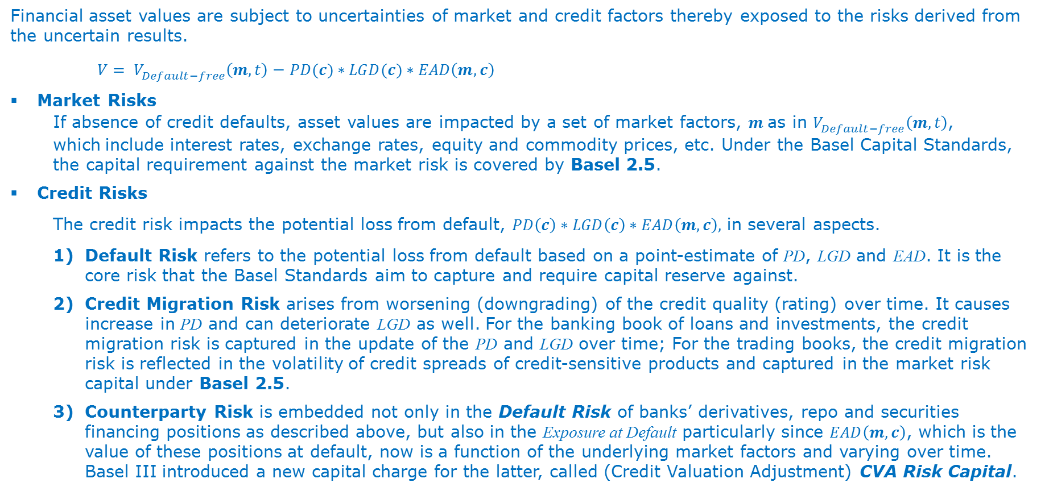
Quantitative Risk Analysis – Risk Types
Financial asset values are subject to uncertainties of market and credit factors thereby exposed to the risks derived from the uncertain results.
${V= V}_{Default−free}^{}\left(m,t\right) \text{−} PD(c)∗LGD(c)∗EAD\left(m, c\right)$
Market Risks
If absence of credit defaults, asset values are impacted by a set of market factors, $m$as in $V_{Default−free}^{}\left(m,t\right)$, which include interest rates, exchange rates, equity and commodity prices, etc. Under the Basel Capital Standards, the capital requirement against the market risk is covered by Basel 2.5.
Credit Risks
The credit risk impacts the potential loss from default, $PD\left(c\right)∗LGD\left(c\right)∗EAD\left(m, c\right),$ in several aspects.
Default Risk refers to the potential loss from default based on a point-estimate of PD, LGD and EAD. It is the core risk that the Basel Standards aim to capture and require capital reserve against.
Credit Migration Risk arises from worsening (downgrading) of the credit quality (rating) over time. It causes increase in PD and can deteriorate LGD as well. For the banking book of loans and investments, the credit migration risk is captured in the update of the PD and LGD over time; For the trading books, the credit migration risk is reflected in the volatility of credit spreads of credit-sensitive products and captured in the market risk capital under Basel 2.5.
Counterparty Risk is embedded not only in the Default Risk of banks’ derivatives, repo and securities financing positions as described above, but also in the Exposure at Default particularly since $EAD\left(m, c\right)$, which is the value of these positions at default, now is a function of the underlying market factors and varying over time. Basel III introduced a new capital charge for the latter, called (Credit Valuation Adjustment) CVA Risk Capital.

Slide 31
Quantitative Risk Analysis – Capital to Capture Tail Risks

Slide 32
Quantitative Risk Analysis – Capital to Capture Tail Risks
The banking business is a risk-taking activity. The goal of risk management is not to eliminate risks, which is not plausible in many cases, but to control and/or mitigate them. The regulatory capital requirements, on the other hand, aim to ensure that banks have adequate capitals to protect them against the tail risks, therefore the capital requirements are viewed as the minimum requirements.
Market Risk Capital
The most popular financial engineering tool to measure tail market risk is the Value-at-Risk (VaR) model. Basel 2.5 adopted the VaR measure as the base to calculate the market risk capital, and defined the tail threshold at 99% confidence interval (with 10-day holding period).
FRTB proposes to replace the point estimate of the tail risk under the VaR measure with an average estimate beyond 97.5% confidence interval (with variable holding periods by market factors).
Credit Risk Capital (Default)
The Credit VaR is also the most popular measure in estimating the tail credit risk. Basel II/III adopted it as the base to calculate the credit risk capital, and defined the tail threshold at 99.9% confidence interval for using the Internal Model Method (IMM) which can be approximated by
The most challenging part of the credit VaR measure is the estimation of Probability of Default (PD) and Loss Given Default (LGD) while the correlations within the asset pool are prescribed by BCBS.
CVA Risk Capital
The VaR measure is also the most effective measure for the CVA tail risk used by banks, although the regulatory rule for the CVA risk capital is not finalized

Slide 33
Appendix: Basel Capital Rule Reading Materials
Basel I: International Convergence of Capital Measurement and Capital Standards
July 1988
http://www.bis.org/publ/bcbs04a.pdf
Basel II: International Convergence of Capital Measurement and Capital Standards, A Revised Framework
June 2006
http://www.bis.org/publ/bcbs128.pdf
Basel II.5: Revisions to the Basel II Market Risk Framework
June 2006
http://www.bis.org/publ/bcbs158.pdf
Basel III: A Global Regulatory Framework for More Resilient Banks and Banking Systems
December 2010 (rev. June 2011)
http://www.bis.org/publ/bcbs189.pdf
New Basel Rule: Minimum Capital Requirements for Market Risk (FRTB)
January 2016
http://www.bis.org/bcbs/publ/d352.pdf
New Basel Rule: Interest Rate Risk in the Banking Book (IRBB)
April 2016
http://www.bis.org/bcbs/publ/d368.pdf

